Slide 1

Generative AI
vs.
Agentive AI:
BY: Sarwat Majeed
(Student Leader)
Roll #: 00331141
Slot: Wednesday 7 to 10

Slide 2
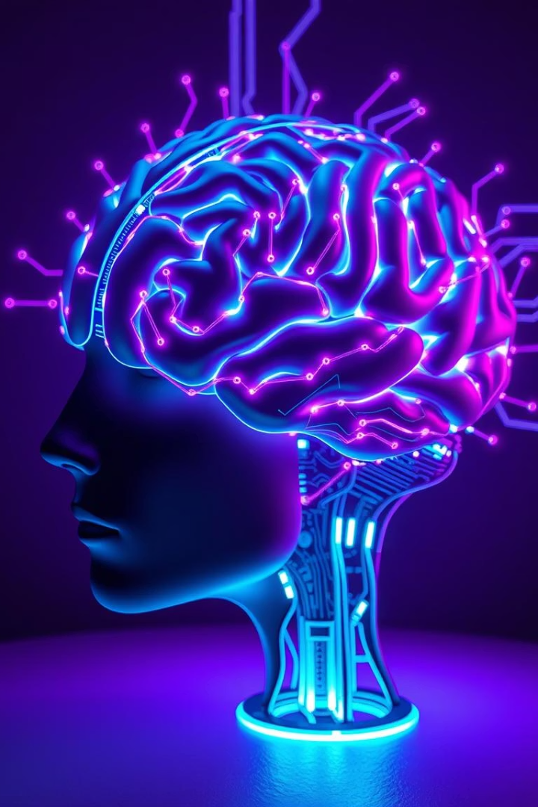
Generative AI vs. Agentive AI: Understanding the Difference
This presentation explores the distinct capabilities and roles of Generative AI and Agentive AI, two groundbreaking artificial intelligence technologies redefining automation and intelligence. We will examine how each works, their unique attributes, and explore real-world applications driving innovation across industries. Understanding these differences is vital for leveraging AI’s full potential in business and society.

Slide 3
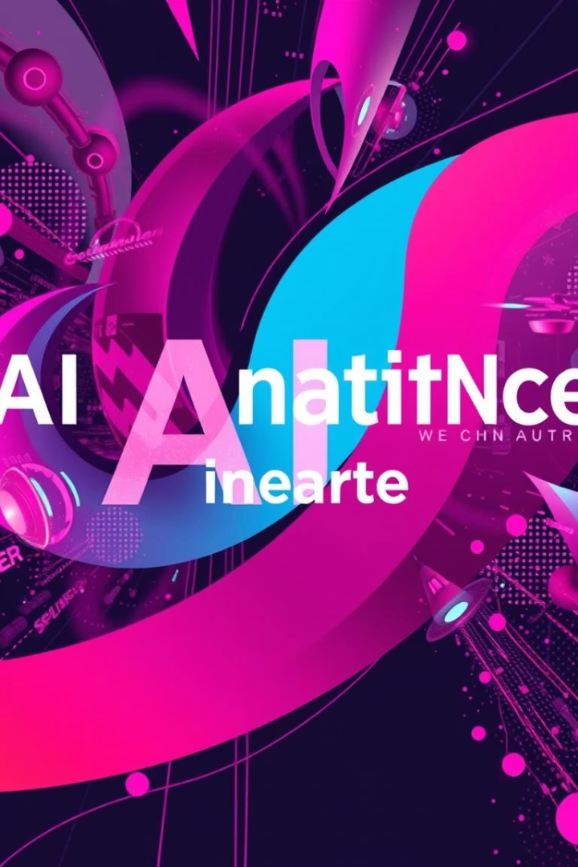
Generative AI: Creating New Content
Definition
Examples
Generative AI models synthesize novel content such as text, images, audio, and video by learning from vast datasets.
Applications include creating realistic photos, composing music, writing articles, and generating synthetic voices.
Key Models
GANs (Generative Adversarial Networks)
VAEs (Variational Autoencoders)
Transformers like GPT and DALL-E

Slide 4
How Generative AI Works: The Process
Training on Data
Pattern Recognition & Generation
Iterative Refinement
Generative AI models absorb patterns from extensive datasets, learning underlying structures including syntax, shapes, and audio patterns.
Models continuously refine outputs through multiple adjustments ensuring high quality and coherence in new creations.
They identify complex correlations and generate original content by extrapolating learned information, exemplified by DALL-E 2 crafting images from text prompts.

Slide 5
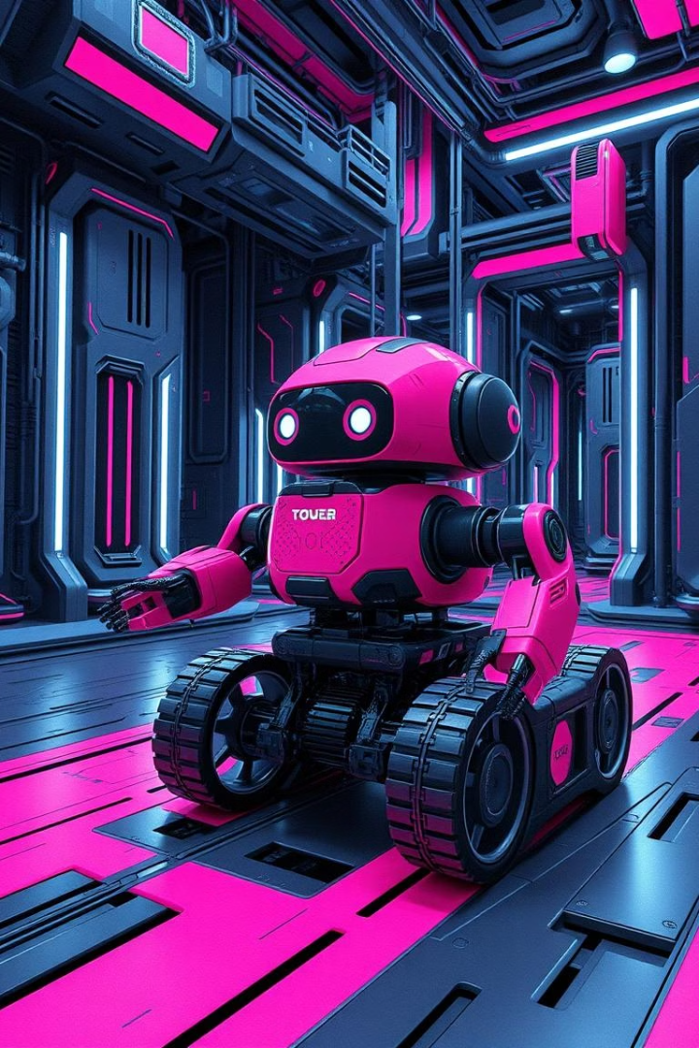
Agentive AI: Autonomous Action
Definition
Goal-Oriented
Agentive AI systems operate independently by perceiving their surroundings, reasoning, and taking actions toward defined objectives.
Focuses on dynamically adapting strategies to complex, changing environments to fulfill specific tasks.
Key Components
Perception through sensors
Planning using algorithms
Execution of actions autonomously

Slide 6
How Agentive AI Works: The Process
Perception
Planning
Action
Agentive AI gathers real-time data via sensors or APIs to understand its environment accurately.
Utilizes algorithms to strategize actions, anticipate challenges, and decide on optimal paths or maneuvers.
Executes planned actions through physical actuators or software controls, exemplified by Tesla Autopilot navigating roads, reducing accidents by 40%.

Slide 7
Key Differences: Autonomy and Creativity
Generative AI
Agentive AI
Generates new and diverse content
Acts autonomously in complex environments
Lacks autonomous decision-making
Limited capacity for original content creation
Output: creative data such as text and images
Output: purposeful physical or software actions

Slide 8

Core Technologies: Generative AI
Deep Learning
Uses multi-layer neural networks to interpret data and generate complex outputs.
GANs
Employ adversarial networks competing to produce realistic synthetic data.
VAEs
Compress and reconstruct data to enable smooth generation of new variations.
Transformers
Process sequences efficiently, forming the backbone for models like GPT-4, which boasts approximately 170 trillion parameters.

Slide 9
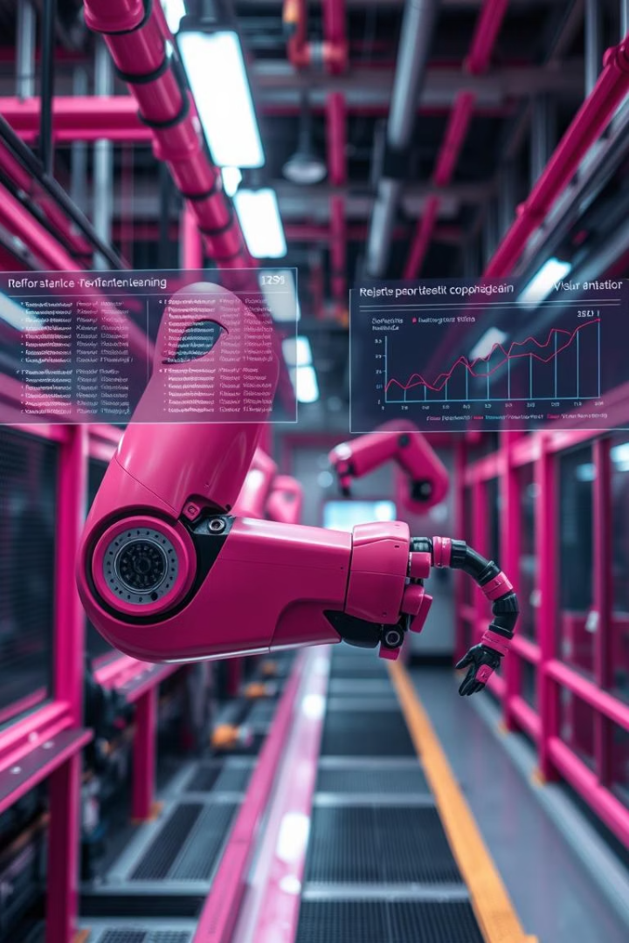
Core Technologies: Agentive AI
Reinforcement Learning
Agents learn optimal actions by trial and error with feedback mechanisms.
Robotics
Integrates AI algorithms with physical machinery enabling autonomous tasks.
Planning Algorithms
Optimize sequences of actions to achieve complex goals efficiently.
Computer Vision
Interprets visual data, essential for navigation and object recognition like A3C outperforming humans in gaming.

Slide 10
Real-World Applications
Generative AI Uses
Agentive AI Uses
Creating digital art and music
Autonomous cars and drones
Automated content writing and code generation
Industrial robots and process optimization
Voice synthesis and video creation
Supply chain automation and smart logistics
Gartner forecasts that by 2027, 70% of enterprises will deploy AI agents, while the AI robotics market is projected to reach $25 billion by 2030.

Slide 11
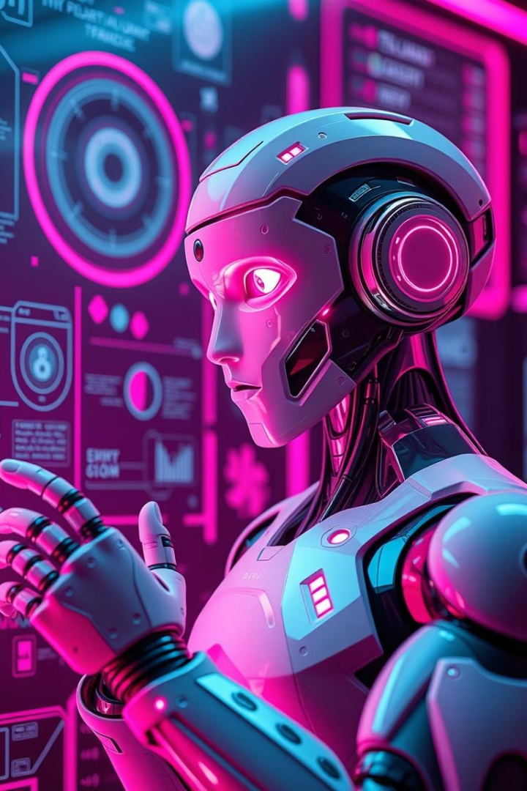



The Future: Convergence and Trends
Integration of AI Types
Combining generative creativity with autonomous decision-making to build powerful AI systems.
AI Co-Pilots
Assist humans in complex tasks, blending creativity with independent action capabilities.
Healthcare Applications
AI agents improving diagnostics and treatment planning, reducing errors by 30%.
The evolving synergy between generative and agentive AI promises more intelligent, creative, and autonomous systems that enhance productivity and innovation across all sectors.

